Slide 1
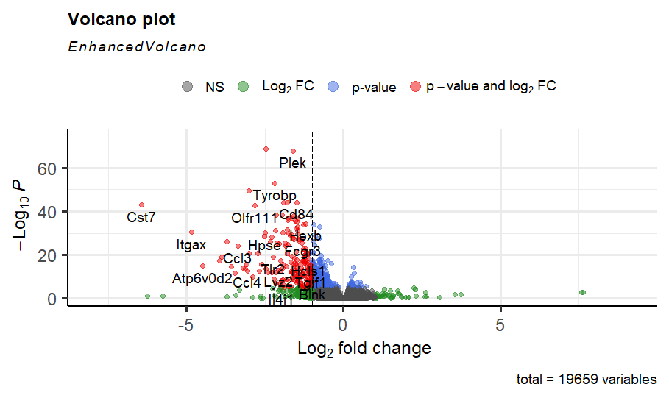
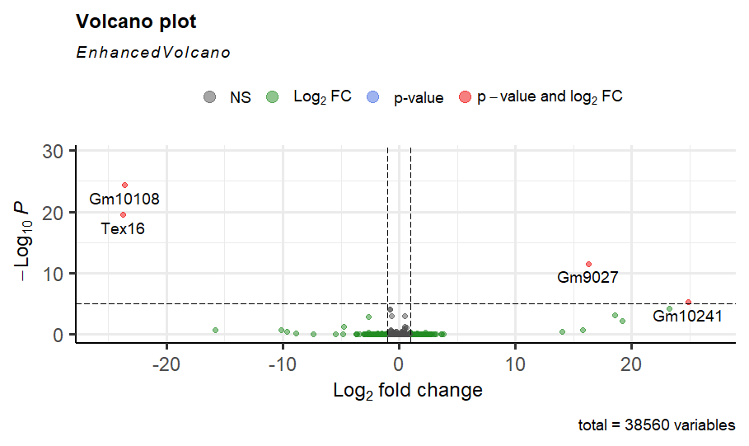
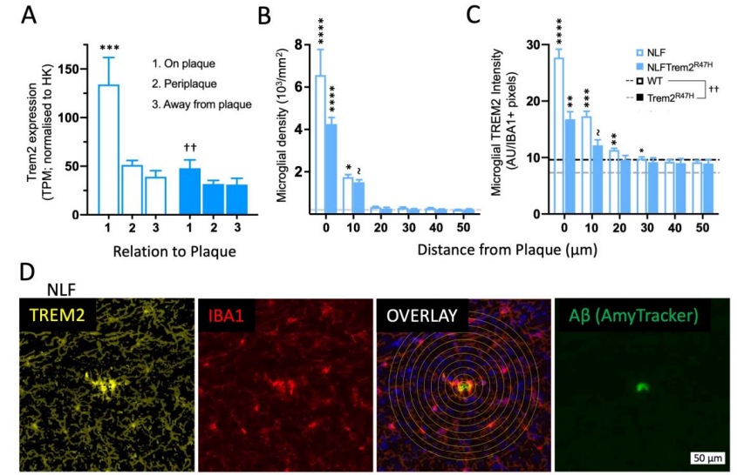
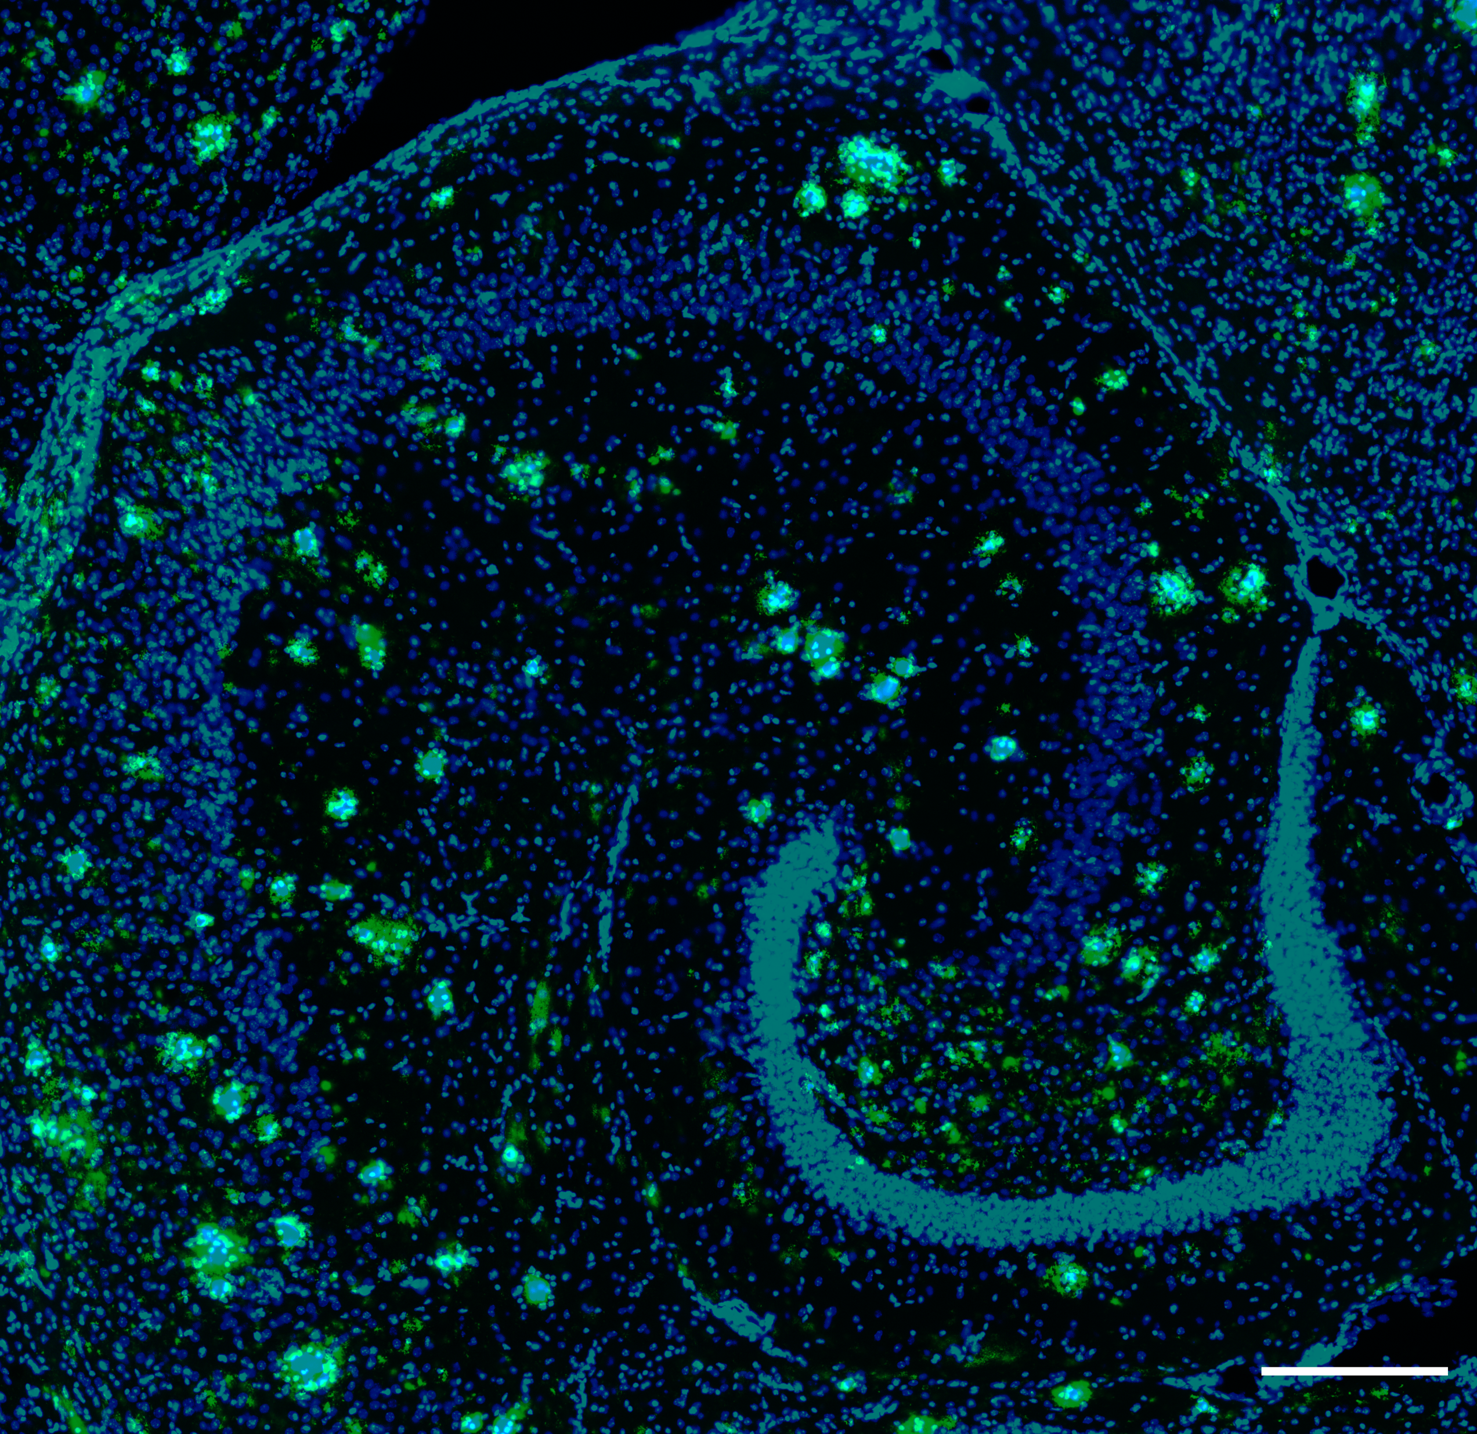
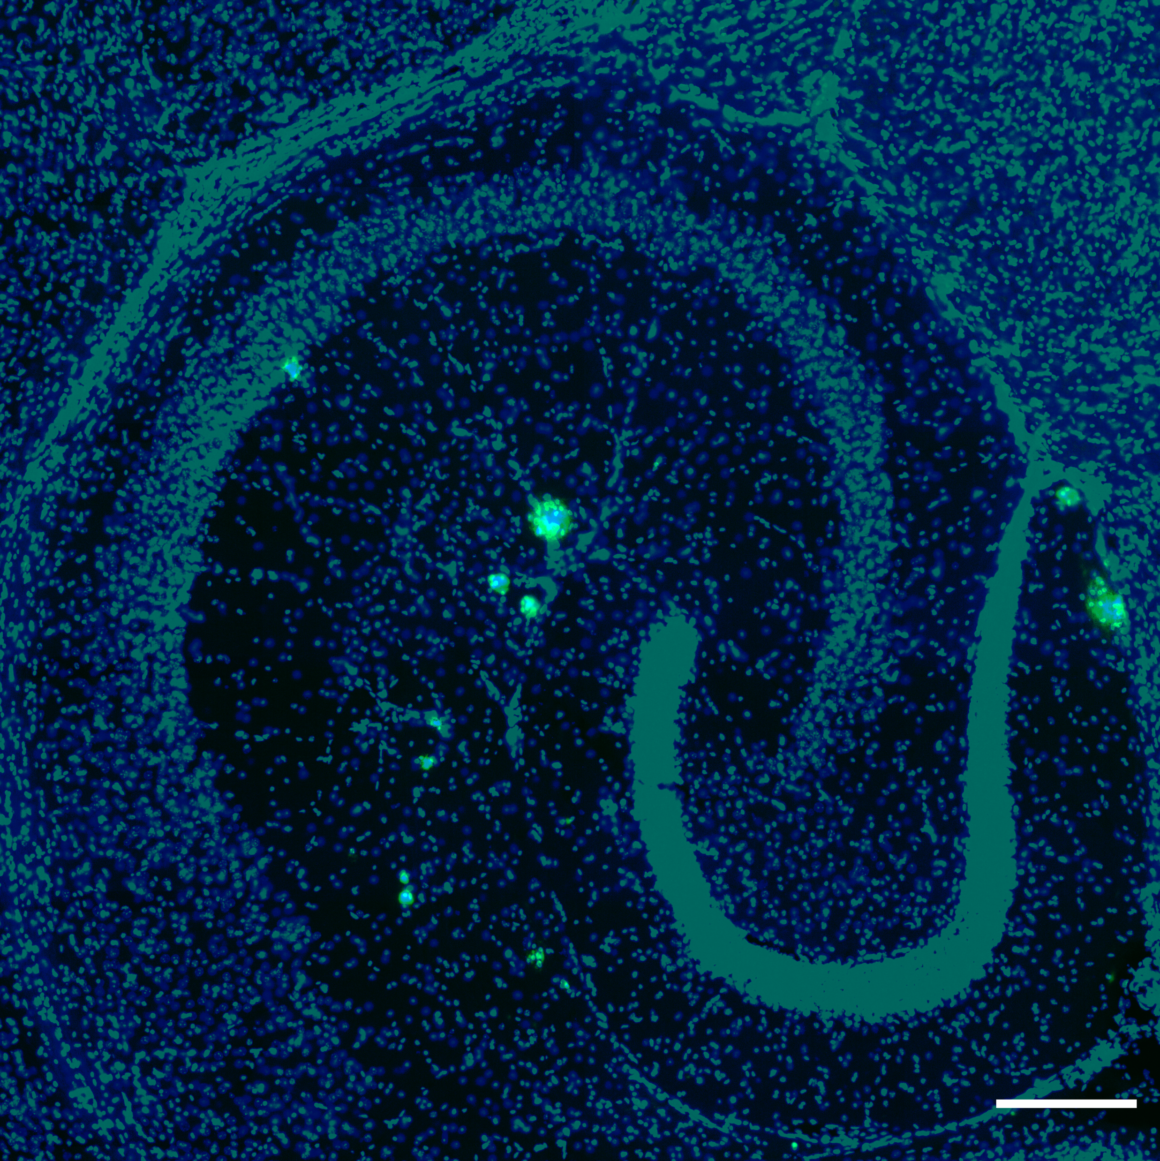
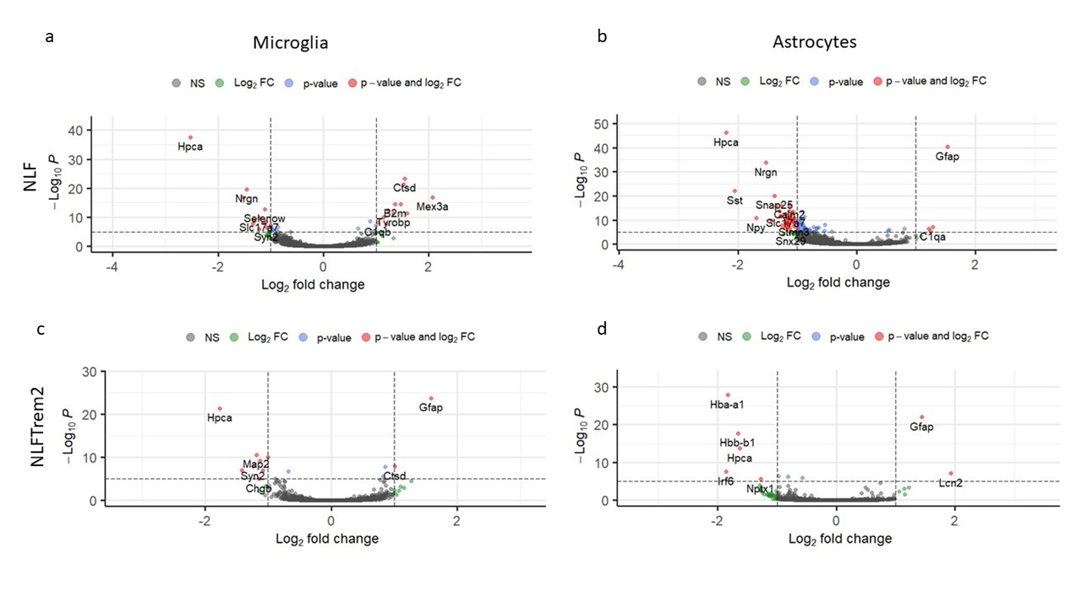
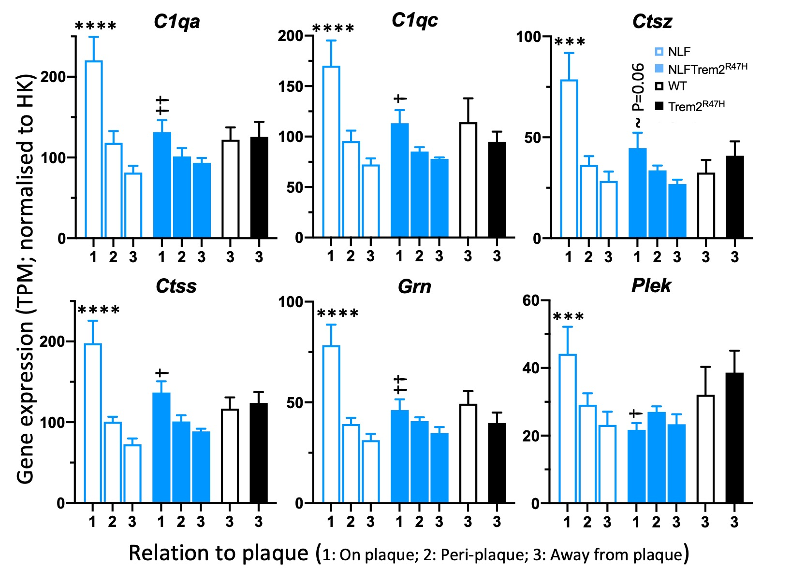
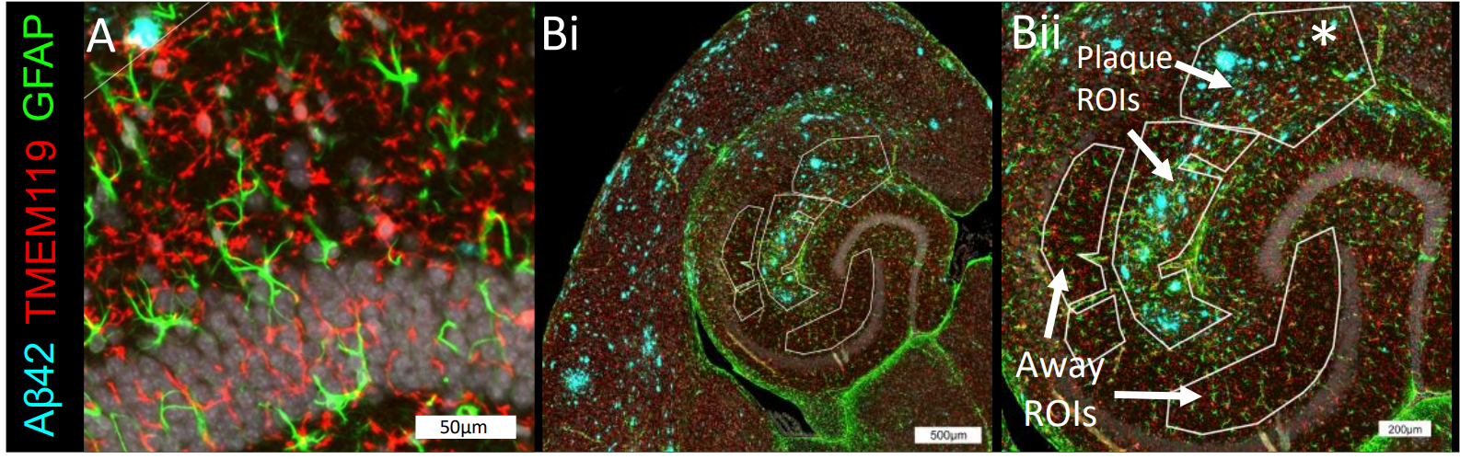
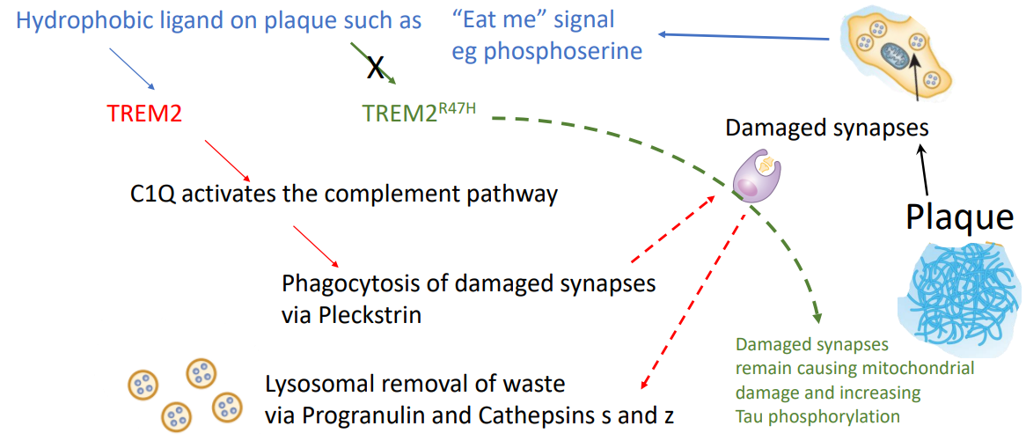



Knock-in mouse model, App^{NLF/NLF}, with slow plaque development into old age, shows plaque specific gene expression pattern more similar to that found in post-mortem tissues from people with Alzheimer’s disease.
Aya Balbaa¹, Jack I. Wood¹, Aishwarya Pathak¹, Eugenia Wong¹, Ridwaan Joghee¹, Sneha Desai¹, Damian M.Cummings¹, Takshashila Tripathi¹, John Hardy¹, Frances A.Edwards¹
¹Department of Neuroscience, Physiology and Pharmacology, UCL
Introduction:
The APPKI mice NLF and NLGF (Saito et al., 2014) are widely used.
NLGF mouse (like many transgenic mice): an aggressive model laying down plaques rapidly from 2 months.
NLF mouse (more like progression of preclinical Alzheimer’s disease): earliest plaques in middle age (around 9 months);slow progression into old age.
New technologies Nanostring GeoMx regional transcriptomics allows study of more relevant.
Age an important factor in gaining translational insites in mouse models.
RNA-Seq from whole hippocampus only useful for NLGF:
# Differentially expressed genes (DEGs)
WT vs NLGF 2410
WT vs NLF ~5 genes NS functional enrich’t
NLGF plaque-induced genes (versus WT)
compared to
NLF plaque-induced genes (vs far from plaque)
Microglial gene modules coexpressing
in NLF in a plaque-dependent manner similar to previously studied genotypes
WT-NLGF
RNAseq
Some microglial genes including Trem2 only increase in expression on plaque contact.
WT-NLF
2225
175
381
Plaque specific within NLF
Trem2 expression Microglial TREM2 protein
Density
WT-NLGF
NLF
On plaque
2. Periplaque
3. Away from plaque
NLFTrem2^{R47H}
NLGF/ NOT NLF
NLF/ NOT NLGF
NLGF
NLF
Human
AD vs Control
2173
359
52 (NSD)
P=0.334
22
P=1.45e-05
308
NLF: Regional cell-enriched transcriptomics: comparing paque and away within tissue brings up 556 DEGs
278
(Lanke et al., 2018
DOI: 10.3389/fnagi.2018.00153)
Methods: Whole hippocampal RNA was extracted from WT, NLF and NLGF mice (n=9-12/genotype; mixed sex; 18 months old).
RNAseq: Differential expression analysis compared WT to NLF or NLGF using DESeq2 R package, batch effect was accounted for as needed.
NLF plaque versus away
NLF-plaque exclusive genes enriched for
synaptic and mitochondrial functions
A small subset are Trem2-genotype-dependent
C1qa
C1qb
Ctsz
Regional cell-type enriched transcriptomics. Nanostring GeoMx technology: AOIs microglia, astrocytes (and underlying synapses) on, near or far from plaques
Microglia
Astrocytes
Ctss
Grn
Plek
Comparing regions with dense plaques (Plaque ROIs) to regions away from plaques (Away ROIs) (n=6, 4 female, 2 male). Analysed using the limma-voom pipeline; within tissue pairing from plaque versus away.
Wood et al., Cell Reports (in press)
aya.balbaa.21@ucl.ac.uk / f.a.edwards@ucl.ac.uk

